Slide 1
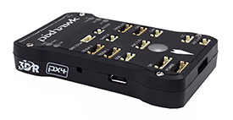

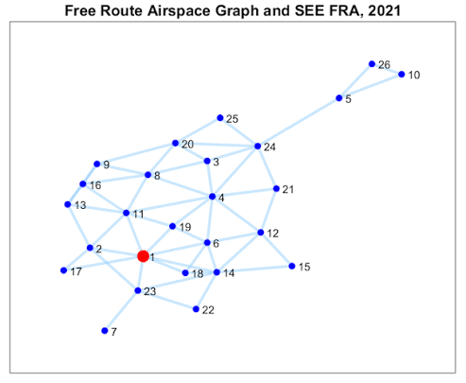
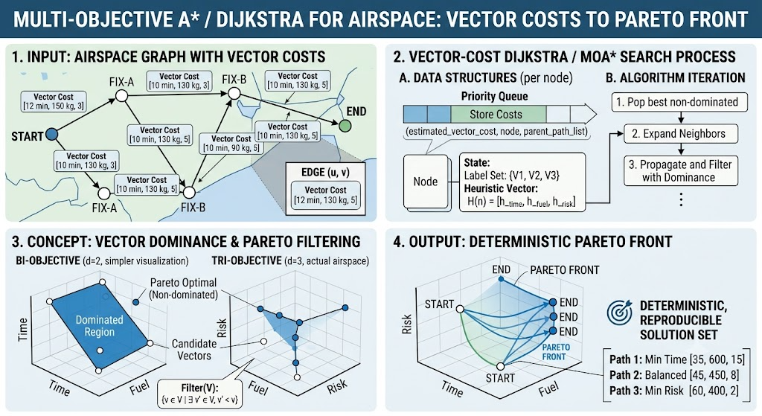

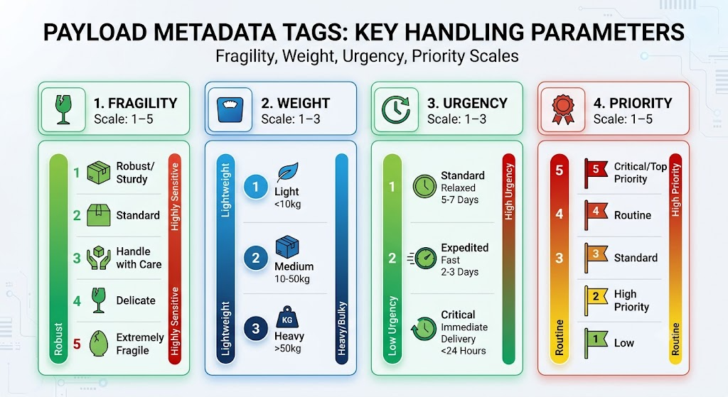
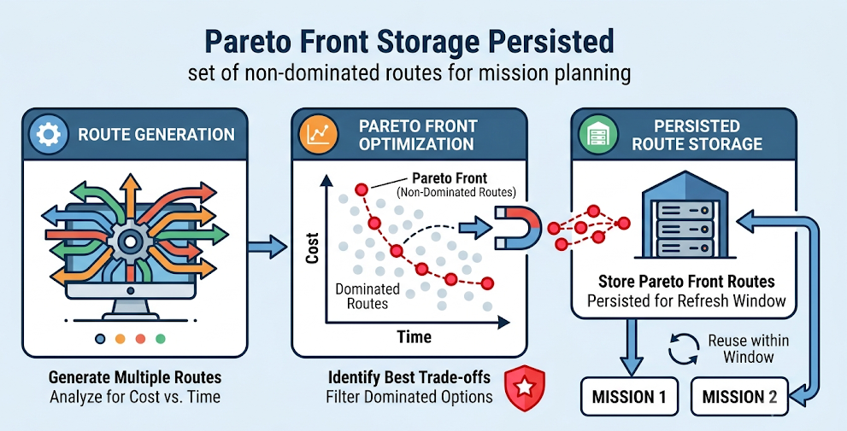
Payload-Aware Two-Tier UAV Route Planning
System Architecture — Deterministic Pareto Front Construction with Payload-Driven Route Selection
① INPUTS & DATA
② TIER 1 — PARETO FRONT CONSTRUCTION
Refreshed periodically per region — not rebuilt per mission
③ TIER 2 — PAYLOAD-DRIVEN SELECTION
Runs per mission — near-instantaneous rule lookup
④ MISSION OUTPUT
⑥ OUTPUTS
Mission File Generation
ArduPilot-compatible .waypoints file from the selected route
Payload-Matched Optimal Route
Airspace Graph
OpenStreetMap (osmnx) — road/path network converted into the delivery-region airspace graph
2.1 Edge Cost Assignment
Each edge gets a 3-objective cost vector: distance (km) · energy (battery %) · flight risk (%)
3.1 Payload Metadata Interpreter
Reads Fragility (F), Weight (W), Urgency (U), Priority (P) tags from operator input
Ground-Station Dashboard
Operator enters payload tag once — no manual re-tuning
Ready-to-Fly Mission File
2.2 Multi-Objective A* / Dijkstra
Vector-cost graph search over the airspace graph — deterministic, reproducible front
3.2 Weight Derivation Formula
w_risk = F·2/Σ w_dist = U·3/Σ w_energy = W·2/Σ — algebraic bridge to Tier 1 objectives
Reusable Pareto Front — no per-mission re-planning
⑤ UAV CONTROL ↻
Payload Metadata Tags
Fragility 1–5 · Weight 1–3
Urgency 1–3 · Priority 1–5
2.3 Pareto Dominance Pruning
Discards any route dominated on all three objectives simultaneously
3.3 Normalisation + Utility Scoring
score(pᵢ) = Σ wₖ·(1−ōbjₖ) computed for EVERY stored Pareto point
MAVLink Upload
Mission file transmitted to the onboard Pixhawk flight controller
Non-Extreme Selection for Mixed Payloads
2.4 Pareto Front Storage
Persisted set of non-dominated routes — reused across missions within the refresh window
3.4 argmax Route Selection
Selects non-extreme points for mixed payloads; priority ≥ 4 amplifies the dominant weight
SITL → Real Flight
ArduPilot SITL validates first; outdoor flight confirms. Route adherence & latency feedback ↻ informs the next refresh
SITL + Flight-Validated Pipeline
payload metadata tags — direct to Tier 2 (bypasses Tier 1)
⑦ PERFORMANCE EVALUATION
Benchmark Scenarios
S1 50n (5%) · S2 200n (20%) · S3 500n (40%)
Pareto Front Quality
Hypervolume (HV) · Pareto Spread / IGD
Tier 2 Selection Accuracy
Alignment of selected route vs. payload tag across mission types
Computation Time
Tier 1 pre-computation vs. MOPSO runtime
Baseline Comparison
vs. Single-Objective A* · MOPSO (100 particles, 200 iter) — mean ± std over 30 runs
Inputs & Data
Tier 1: Pareto Construction
Tier 2: Payload Selection
Mission Output
Control & Feedback
Evaluation
This architecture separates deterministic Pareto front construction (Tier 1) from instantaneous payload-driven route selection (Tier 2), connected by an explicit algebraic weight-mapping bridge from payload metadata to routing objectives.

